Slide 1





Reconfiguring the ASEAN Framework: General Equilibrium Impact of Australia's Inclusion and India's Exclusion - A Structural Gravity Model Analysis
ECO412A: International Economics and Finance
Submitted By- Debashree Priya Sahoo
Roll no-200307

Slide 2
Introduction
International trade serves as a critical driver for economic advancement, innovation, and intercultural dialogue in the 21st century.
ASEAN engages in trade agreements to lower trade barriers, expand market access, and promote fair competition among member countries.
ASEAN is a blend of countries with varying economic strengths, including natural resources, manufacturing, and emerging tech sectors.
Holds a strategic position that bridges Eastern and Western markets, making it a major player in the global economy.
Despite internal differences, ASEAN countries share a commitment to peace, stability, and economic growth.
The rapidly evolving landscape of global trade necessitates ongoing evaluation and reassessment of international trade agreements.
Australia and India’s strong economy, technological prowess, and geographical proximity make it an intriguing candidate for ASEAN membership.
Pros and Cons of Inclusion: The hypothetical inclusion of Australia and India into ASEAN could either amplify the bloc's economic influence or introduce new dynamics and challenges that require careful analysis.

Slide 3

Objective and Significance
Employ a structural gravity model to examine the general equilibrium effects of potential changes in the ASEAN Trade Agreement(AFTA) on bilateral trade among its member countries.
Multifaceted Analysis- Understand the success of the trade agreement in fostering bilateral trade and growth.
Analyze exports, tariffs, border policies, and other economic variables.
Counterfactual Analysis- Simulate alternative trade scenarios, by adding Australia and removing India in ASEAN.
Assess how changing AFTA's membership could enhance or challenge existing dynamics.
Expanded Examination- Assess impact on 6 non-member countries that share strong trade ties with both Australia and India .
Explore the consequences of ASEAN on general economic equilibrium among non-member and member states.
Incorporate trade diversion and creation effects for a nuanced analysis.
Gauge the overall economic welfare effects of the ASEAN Trade Agreement.
Provide critical insights for policymakers in both member and non-member states.

Slide 4
Literature Review
Summarize previous research that utilized the gravity model to assess trade agreement effects on the flow of goods and services.
Research discusses the two primary effects: Trade Creation (TC) and Trade Diversion (TD).
If TC > TD, Free Trade Agreement succeeds in boosting national welfare and economy.
Francis (2011) - Summarize India's trade shifts and concerns related to ASEAN-10 and trade liberalization.
Bergstrand [1985, 1989]- laid the foundational principles for the gravity model, which considers economic factors in both exporting and importing countries and natural or artificial factors influencing trade between partners.
MacPhee et al. (2014)- Reports negative intra-bloc effects in specific Regional Trade Agreements.
Subhash Jagambe and Elumulai Kannan (2020)- ASEAN-India FTA Impact, Present positive outcomes for India's agricultural trade.
Anderson and Wincoop (2003)- introduced the "structural" gravity model, incorporating Multilateral Trade Resistance terms and addressing estimation issues in traditional models.
Eaton and Kortum (2002)- established a connection between trade volume and trade barriers related to technology and geography.

Slide 5
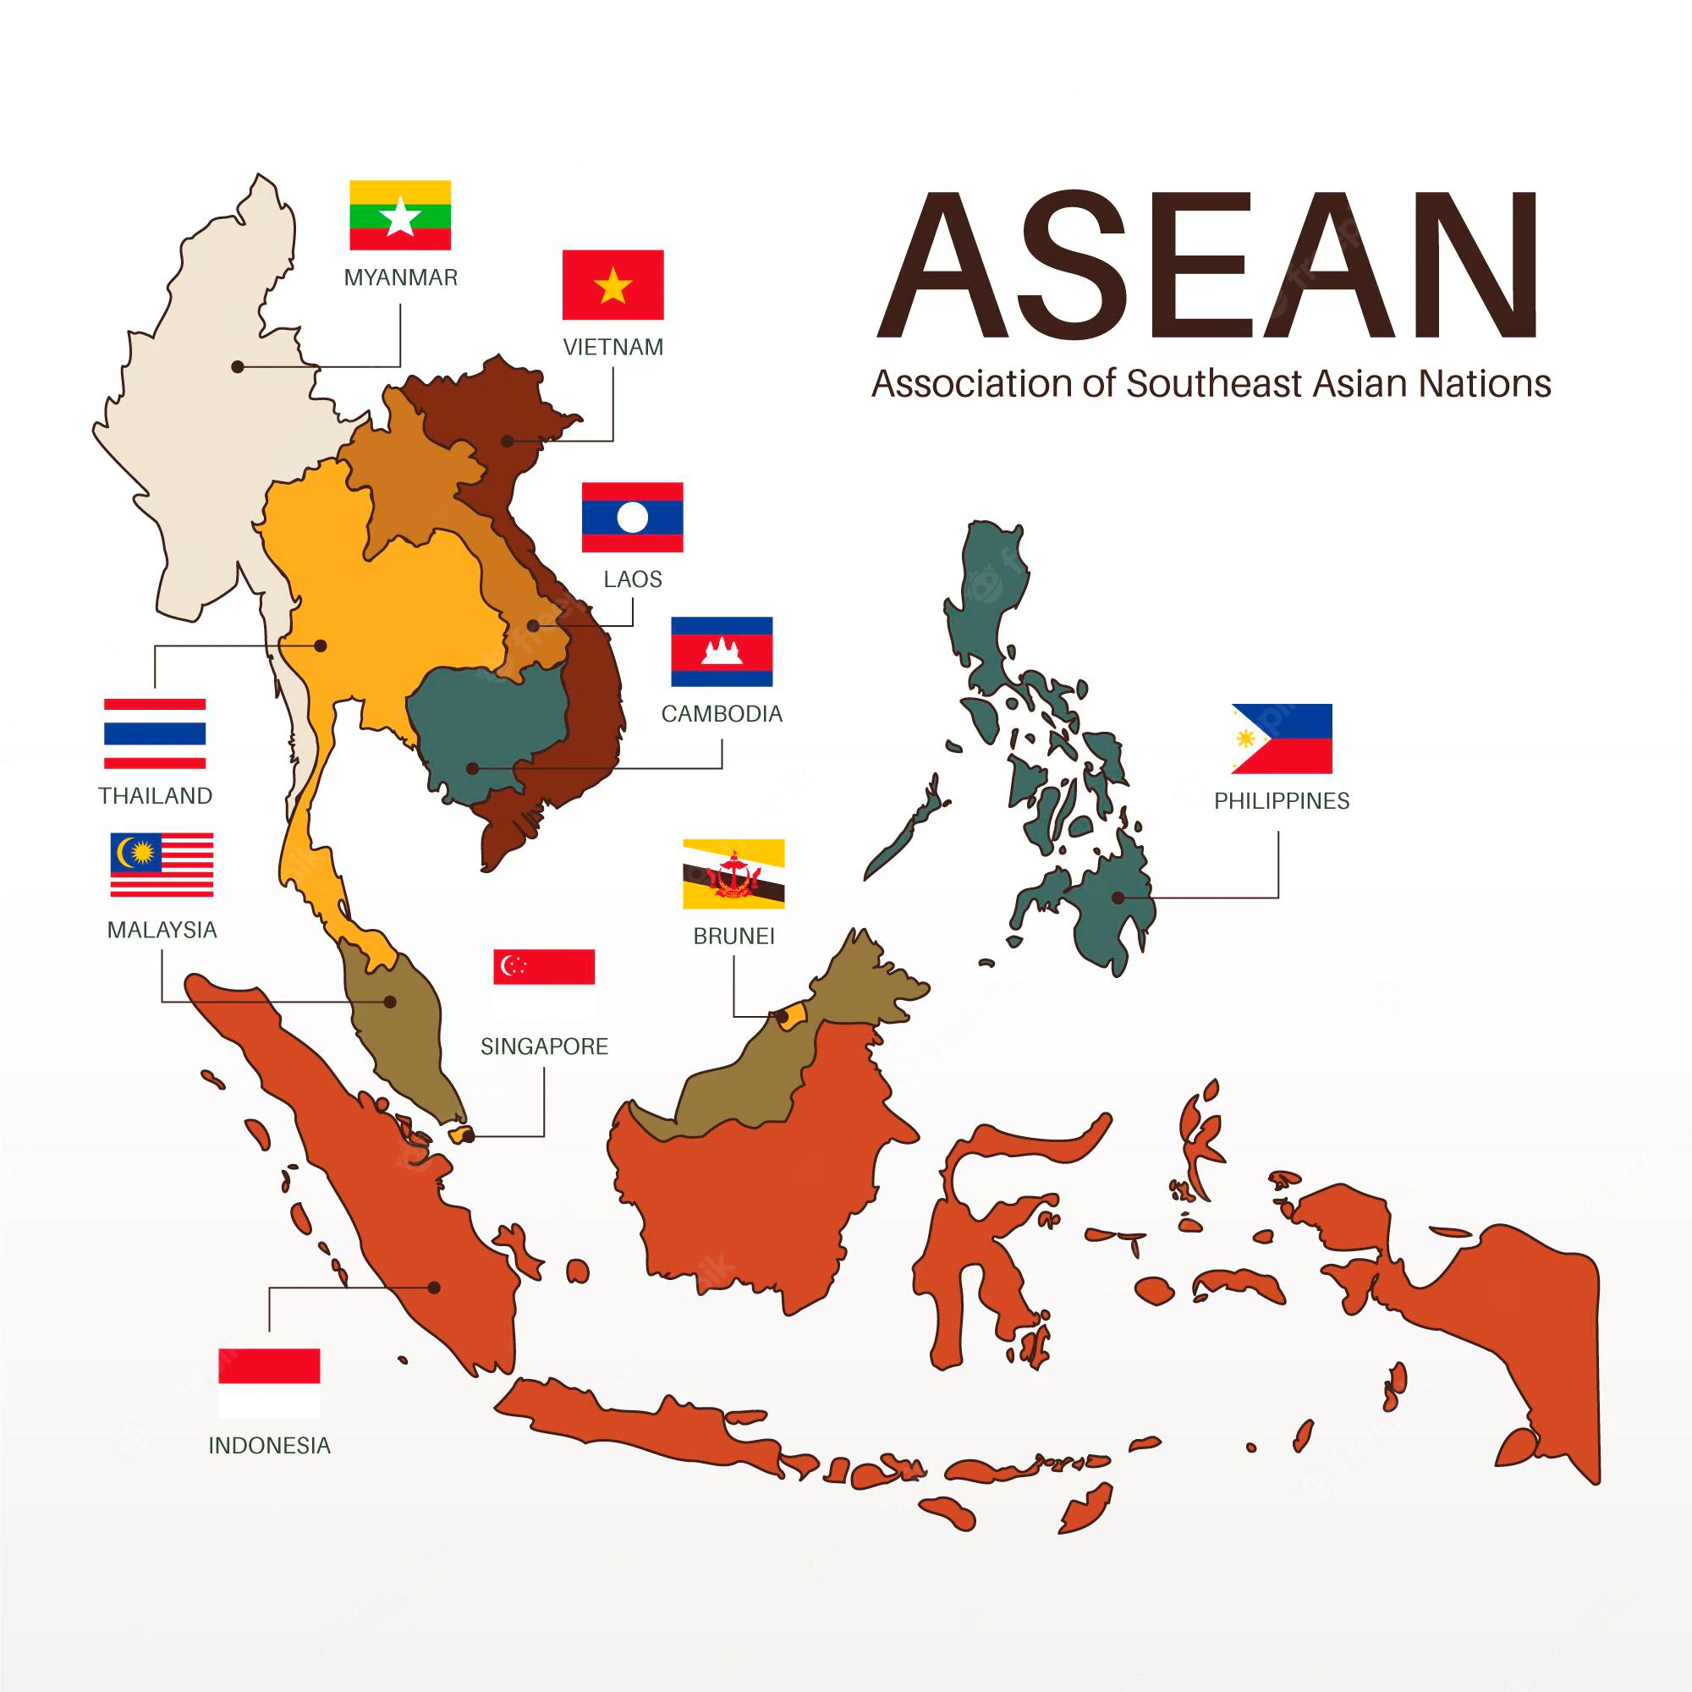

Slide 6
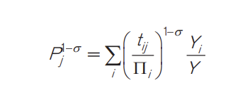
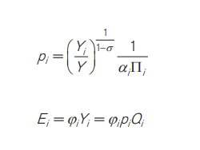
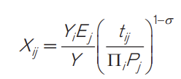
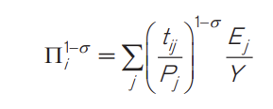
Base Model
The Structural Gravity framework as given by Anderson and Eric Van Wincoop will be used in our analysis which incorporate multilateral resistance terms. Handling for this multilateral resistance terms will account for factors that affect trade beyond just bilateral trade costs between two specific countries
Where
Xij - nominal trade flows from exporter i to destination j country
Ej- total expenditure in importer j
Yi - value of total production in exporter i
Y - value of world output
tij - denotes bilateral trade frictions between partners i and j
σ >1- elasticity of substitution among goods from different countries
αi - CES preference parameter
P_{j} - Structural term that denotes inward multilateral resistance terms
Πi - Structural term that denotes outward multilateral resistance terms
pi - factory-gate price for each variety of goods in the country of origin i
Qi -endowment or quantity supplied of each variety of goods in country i
φi -exogenous parameter, defining the relation between the value of output and aggregate expenditure,
If φi > 1, country i faces a trade deficit,
0<φi<1 country i runs a trade surplus
Both structural terms defined by Anderson and van Wincoop (2003)

Slide 7
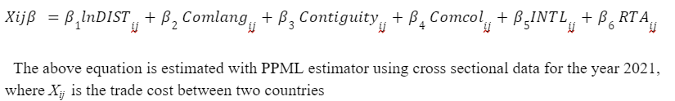
Methodology
PPML Estimation
Equation for the Structural Gravity Model (PPML estimation) controlling for multilateral resistance terms with fixed effects. The PPML is a preferred estimator because of its ability to do well in data with heteroscedasticity (as is the case with most countries’ trade data) and the ability to deal with zero values (Santos Silvas and Tenreyro 2006).
Specified Model
Xij= exp[π_{ij} + χ_{ij} + µ_{ij} + β₁lnDIST_{ij} + β₂ CNTG_{ij} + β₃ INTL_{ij} + β₄ RTA_{ij} + β₅ TB_{ij} + β₆ LANGij ] * ε_{ij}
π_{ij}- Exporter Time fixed effects
Χi_{j}- Importer time fixed effects
µ_{ij} -Pair Fixed effects
RTAij- denotes the presence of a country in RTA, it takes up value 1 when the countries have signed an RTA and is used for counterfactual purposes. This term also handles the trade creation and trade diversion effect
𝐷𝐼𝑆𝑇𝑖𝑗 - denotes the bilateral distance between countries i and j
CNTGij - dummy variable which shows contiguous borders between trading partners i and j
TB_{ij} - denotes trade barriers( tariff rates) between country i and j
LANGij- dummy variable for the existence of a common official language between partners i and j
INTLij - dummy variable takes 1 for international trade between countries i and j, and 0 otherwise

Slide 8
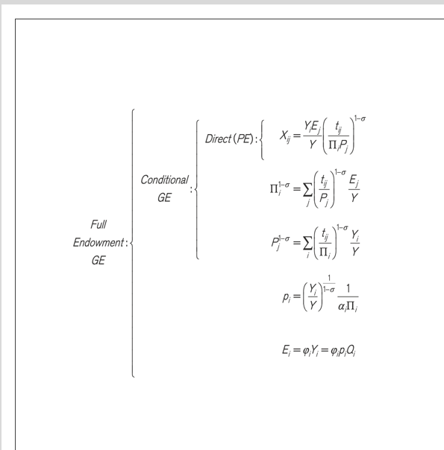
General Equilibrium Effects of Trade policy
Here, p_{i} is the factory gate price for each variety of goods in the country of origin i, Q_{i} is the endowment or quantity supplied of each variety of goods in country i, Φ_{i} is an exogenous parameter.

Slide 9
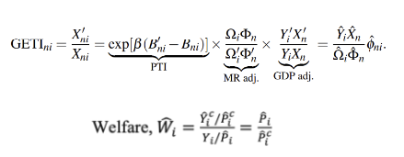
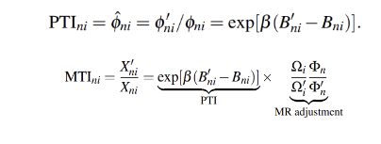
General Equilibrium Effects of Trade policy
Once we have estimated the trade cost elasticities, estimates of fixed effects along with output and expenditure data, then GE analysis estimates will be constructed. The process will be repeated for conditional and full endowment scenarios. Here we follow the works of Head and Mayer (2014) and Yotov (2016).
For General Equilibrium (GE) analysis, we will evaluate four metrics: Partial Trade Impact (PTI), Modular Trade Impact (MTI), General Equilibrium Trade Impact (GETI), (as given by Head and Mayer, 2014) and Welfare(Anderson, Larch, Yotov, 2017).
PTI focuses on the 'partial' effects of changes in trade costs, capturing their direct impact without considering Multilateral Trade Resistance (MTR) terms or fluctuations in output and expenditure. MTI goes a step further by including the effects of changing inward and outward MTR terms due to trade cost alterations, offering a conditional GE perspective. GETI provides the most comprehensive view, taking into account changes in production, expenditure, MTR terms, and PTI, to measure the full equilibrium impact of variations in trade costs.
Last Step is the counterfactual Scenario Analysis

Slide 10
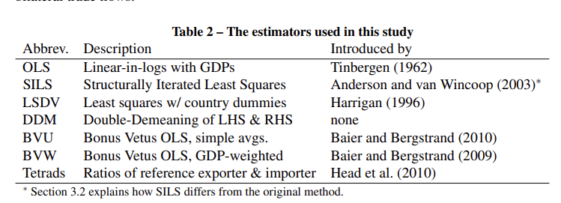
Other estimators that can be used

Slide 11
ASEAN NATIONS
Indonesia
Malaysia
Philippines
Singapore
Thailand
Brunei
Vietnam
Laos
Myanmar
Cambodia
India(added recently)
NON-MEMBER
STATES
Australia
China
United States
UAE
Japan
How RTA Dummy Variable issue gets solved
Inclusion of the non-member states will help to address the issue of RTA dummy variable=1, when Australia or India will get added to ASEAN and no non-member states will be there resulting RTAij=1 for every country
But when non-member states are included RTA=0 for them and RTA=1 for those in member states FTA agreement
These are the member states, part of the ASEAN Free Trade Area(AFTA) agreement.
These are the non-member states that have good trade relation with both Australia And India
So in total there are 16 countries, so total trading partners and relationships are 16P2 that accounts for inter trade or bilateral trade between countries and 16 for intra trade, so total is 240+16=256 trading partners/relations, that is to form a Square Dataset as it is essential for general equilibrium effect estimation.
Cross Section analysis will be done to estimate and compare the results.

Slide 12

Initial Idea
1.Baseline Assessment
Evaluate the general equilibrium (GE) impact of the ASEAN Free Trade Agreement (AFTA) on trade between member and non-member states
GE analysis, will consider Partial Trade Impact (PTI), Modular Trade Impact (MTI), GETI (General Equilibrium Trade Impact) (as given by Head and Mayer, 2013) and Welfare (Anderson, Larch, Yotov 2017)
3. Counterfactual Analysis – Removing India
Modify the GE model once again by removing India from ASEAN and check GE effects
4. Comparative Analysis
Determine either addition of Australia or removal of India is more impactful for ASEAN.
Use GEPPML estimation method for robust comparison.
Summarize which country's inclusion is more beneficial or impactful for ASEAN, based on the analyses.
2. Counterfactual Analysis - Adding Australia
Modify the original GE model and check the GE impact to include Australia as a member state.

Slide 13
Variables
Variable Type | Notation
GDP | gdp_o and gdp_d
Tariff | tariff
Trade | Trade_o
Contiguity | contig
Common Language | comlang_off
International Dummy | international
FTA | asean_FTA
Distance b/w exp and imp | dist

Slide 14
pip install gegravity import gegravity as ge import pandas as pd # Increase number of columns printed for a pandas DataFrame pd.set_option("display.max_columns", None) pd.set_option('display.width', 1000) import gme as gme Next, load the gravity data from google.colab import files uploaded = files.upload() gravity_data_location = "/content/DEBASHREE_FINALDATASET_200307.csv" grav_data = pd.read_csv(gravity_data_location) df = pd.read_csv('/content/DEBASHREE_FINALDATASET_200307.csv') print(grav_data.head()) Prepare data and econometric inputs for GE model #Define GME Estimation Data gme_data = gme.EstimationData(grav_data, # Dataset imp_var_name="iso_o", # Importer column name exp_var_name="iso_d", # Exporter column name year_var_name = "year", # Year column name trade_var_name=“trade_o") # Trade column name #Create Gravity Model gme_model = gme.EstimationModel(gme_data, # Specify data to use lhs_var="TRADE", # dependent, "left hand side" variable rhs_var=[ "tariff","contig","comlang_off","comcol",# independent variables “lndist", "pta",“international"], fixed_effects=[["iso_o"],["iso_d"]]) # Fixed effects to use
Codes

Slide 15
# Estimate gravity model with PPML
gme_model.estimate()
# Print econometric results table
print(gme_model.results_dict['all'].summary())
After econometric estimation, now we solve the baseline model. We assume India is the reference importer, and take cross section sample for year 2021
# Define GE model
ge_model = ge.OneSectorGE(gme_model, # gme gravity model
year = "2021", # Year to use for model
expend_var_name = "gdp_d", # Expenditure column name
output_var_name = "gdp_o", # Output column name
reference_importer = “ARE", # Reference importer
sigma = 5) # Elasticity of substitution
The following commands are not required to define or solve the GE model but can help diagnose issues that arise if the model fails to solve.
# Test that the model system of equations is computable from the supplied data and parameters
test_diagnostics = ge_model.test_baseline_mr_function()
# See what is returned:
print(test_diagnostics.keys())
# Check the values of the model parameters computed from the baseline data, which should be numeric with no missing
# values
input_params = test_diagnostics['mr_params']
# Check one set of parameters, for example:
print(input_params['cost_exp_shr'])

Slide 16
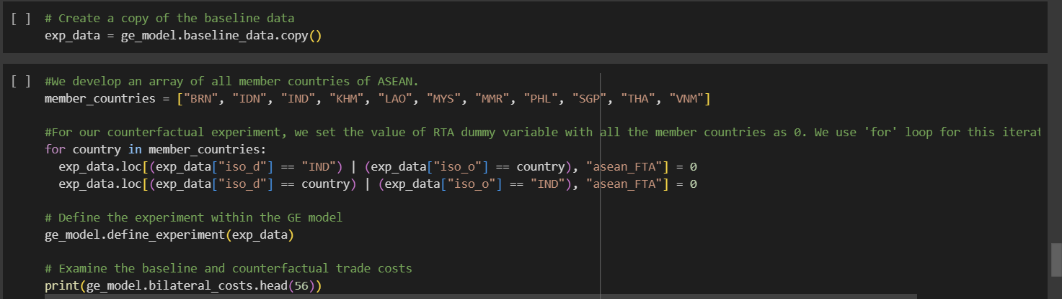
Check scaling of outward multilateral resistances (OMRs)
# Check for OMR rescale factors that results in convergence
rescale_eval = ge_model.check_omr_rescale(omr_rescale_range=3)
print(rescale_eval)
# Solve the baseline model
ge_model.build_baseline(omr_rescale=100)
# Examine the solutions for the baseline multilateral resistances
print(ge_model.baseline_mr.head(16))
Counterfactual-1
India Leaves ASEAN

Slide 17
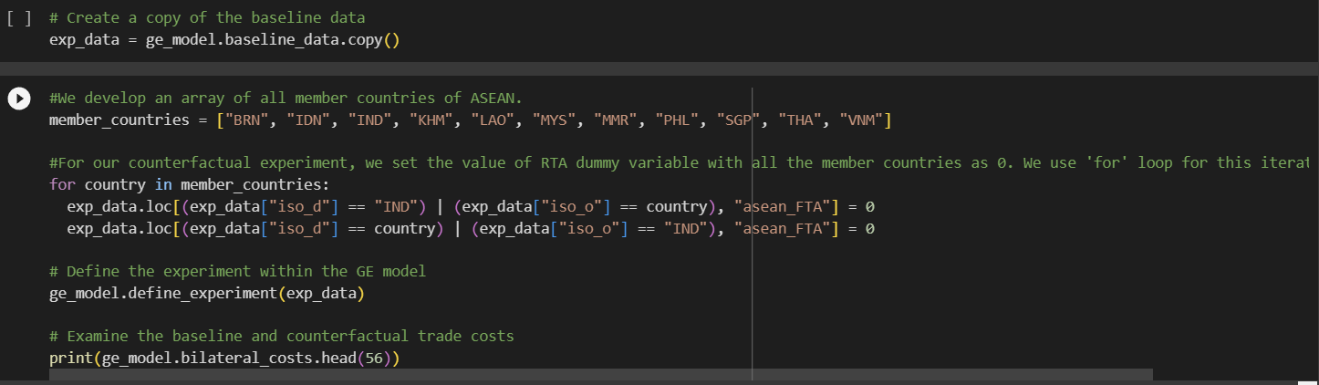
Counterfactual-2
Australia Joins ASEAN
# Simulate the counterfactual model
ge_model.simulate()
# We can examine the counterfactual trade flows predicted by the model.
print(ge_model.bilateral_trade_results.head())
# A collection of many of the key country-level results (prices, total imports/exports, GDP, welfare, etc.)
country_results = ge_model.country_results
print(country_results)
# The bilateral trade results
bilateral_results = ge_model.bilateral_trade_results
print(bilateral_results)
# A wider selection of aggregate, country-level trade results
agg_trade = ge_model.aggregate_trade_results
print(agg_trade)

Slide 18
# country multilateral resistance (MR) terms
mr_terms = ge_model.country_mr_terms
# Get the solver diaganoistics, which is a dictionary containing many types of solver diagnostic info
solver_diagnostics = ge_model.solver_diagnostics
mr_terms = ge_model.country_mr_terms
print(mr_terms)
solver_diagnostics = ge_model.solver_diagnostics
# Export the results to a collection of spreadsheet (.csv) files and add trade values in levels to the outputs.
from google.colab import drive
drive.mount('/content/drive’)
import os
output_directory = "/content/drive/My Drive/"
os.makedirs(output_directory, exist_ok=True)
ge_model.export_results(directory=output_directory, name="GE_analysis")

Slide 19
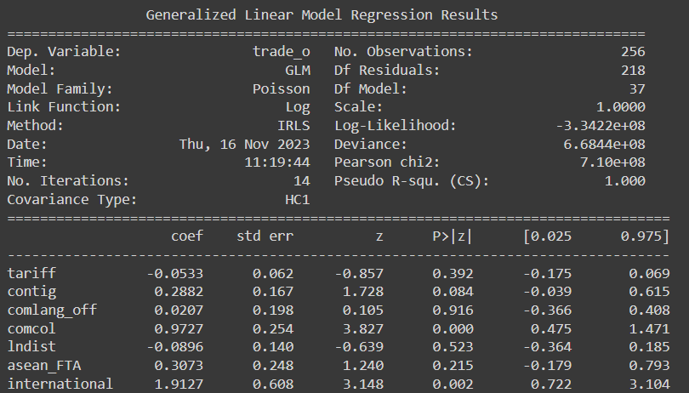
Results
The negative coefficient for tariffs (-0.0533) suggests that increased tariff rates are likely to decrease trade flows, aligning with conventional economic theory.
contig has a positive effect (0.2882) and is significant at 1% level, indicating that countries sharing borders tend to engage in higher trade volumes.
The coefficient for common colonial history (comcol) is significant and positive (0.9727), reaffirming the historical ties that often enhance trade
The ASEAN Free Trade Agreement (asean_FTA) variable shows a positive coefficient(0.3073) indicating FTAs increase the trade volume, but not statistically significant, which may be due to some missing other important variables that are not taken into consideration like prevalence score which may affect the significance of the variable
International border dummy has a positive coefficient (1.9127) and is highly significant suggesting that economic integration of countries and global dynamics has a positive association with trade volumes and helps in shaping trade patterns.
lndist has a negative coefficient which suggests increasing distance trade reduces which is economically true, but it is not significant.
Structural Gravity Model Estimates
Here Trade is the Dependent variable

Slide 20
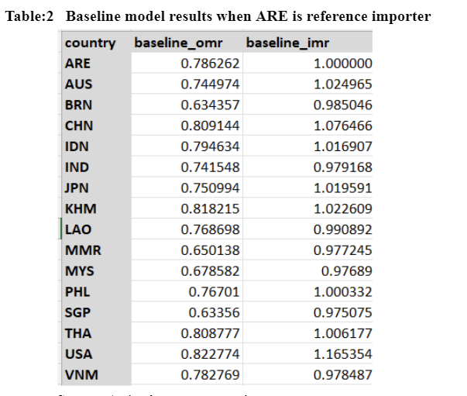
Baseline Model Results
Baseline IMR (Importer Multilateral Resistance) measures a country's general resistance to imports, while baseline OMR (Exporter Multilateral Resistance) measures a country's general resistance to exports, both reflecting non-policy trade barriers such as geographical or economic factors.
The baseline IMR for a country reflects the resistance to imports that is faced by that country from all partners. If another country's IMR is greater than 1, it faces more resistance to imports than India; if it is less than 1, it faces less resistance.
The baseline OMR for a country represents the resistance to exports faced by producers in that country. An OMR less than 1 implies less resistance and an OMR greater than 1 implies more resistance.

Slide 21
INDIA’S EXIT

Slide 22
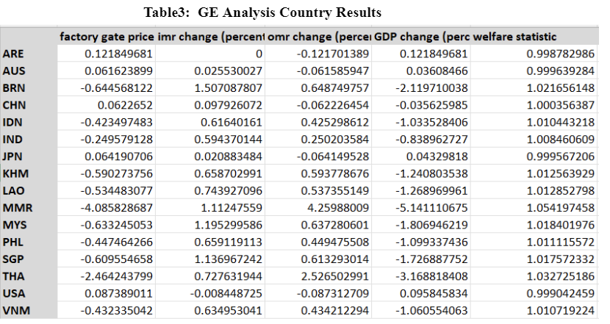
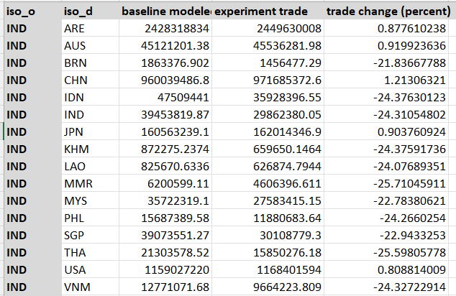
Country and Bilateral Results after Implementation of Counterfactuals
INDIA

Slide 23
Country Result Interpretation for India
The welfare statistic likely measures the economic well-being of each country after India's exit from ASEAN. The marginal positive values in the welfare statistic column could indicate that, according to this model, the countries listed experience a slight increase in economic welfare in the scenario where India leaves ASEAN.
The reason is may be due to trade diversion to other countries, resource allocation from India to other countries, leading to a small welfare gain and exit of a major economy like India could open up market opportunities for smaller countries
GDP Change- Negative GDP change for member countries show that India’s exit, led to loss of economic integration benefits, such as reduced trade flows, investment, and cooperative economic activities. Positive Change for non member countries show that with India no longer part of ASEAN, both India and non-members may look to strengthen bilateral trade relations, potentially increasing trade outside the ASEAN bloc, Non-member countries could gain a competitive advantage in markets where Indian goods and services were previously favored due to preferential ASEAN trade terms, which may no longer apply.
Factory Price changes are negative for all countries suggesting India's departure from ASEAN could lead to reduced demand for certain goods that India was importing, causing a decrease in prices to stimulate sales. The exit of India might intensify competition among remaining ASEAN members to capture the market share, driving down prices and can lead to realignment of trade relations
The OMR changes are mostly positive for ASEAN member countries, which suggests that these countries are facing increased resistance to exporting goods after India leaves the bloc. This could be due to loss of trade synergies, increased logistic costs,
The IMR changes have increased for member countries which suggest the remaining ASEAN countries might adjust their trade agreements making it easier for member countries to import from each other or from alternative partners. Non member countries face decreased import resistance. They might see this as an opportunity to strengthen trade relations with India

Slide 24
The baseline modeled trade, which represents the initial trade flows as per the model before any changes, and the experiment trade, which simulates the counterfactual scenario where India leaves a trade agreement or bloc.
From the data provided, it appears that for member countries, trade volumes decrease when India leaves (as shown by the negative percentages), which is expected since the removal of a major economy like India would typically disrupt existing trade patterns and reduce overall trade volumes due to increased trade costs.
But for non member countries there is a positive trade change suggesting that trade diversion will occur and new market opportunities will be available that were previously dominated by India

Slide 25
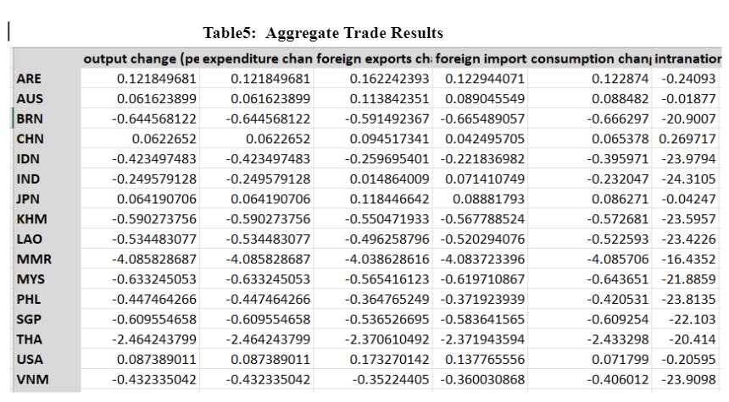
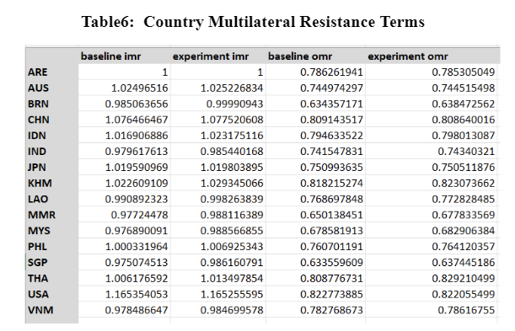
INDIA

Slide 26
India sees a -0.23% change in consumption, indicating a decline in domestic consumption. This drop may be due to reduced household income or increased savings rates in the face of economic uncertainty following the exit. Member countries uniformly experience negative consumption changes. This could be a result of decreased consumer confidence, reduced disposable income, or increased prices due to the potential rise in trade costs with India.
The marginal increase in both exports and imports for India suggests that trade activity with countries outside of the trade bloc with other economically strong nations has increased, but there is a disruption of established trade links with ASEAN members
The increase in exports points to foreign demand or competitiveness of Indian goods abroad, while the import increment could result from general increase in consumption and investment in domestic goods. Member countries experience a decrease in both exports and imports from India, which suggest that they lose a key export destination and a source of imports, .
India's market is substantial, and its absence would directly reduce the size of the ASEAN market, leading to a significant reduction in trade volumes for member countries but Non-members may have more readily available alternative markets to compensate for any loss of trade with ASEAN, mitigating the impact on their imports and consumption.
For ASEAN members, the experimental IMR is marginally higher than the baseline, indicating an increase in resistance to imports, which could result from seeking new import sources or improving domestic conditions for imports in response to India's exit.
Experiment OMRs have marginally increased for member countries which show that now after India’s exit, ASEAN members are facing slightly more resistance in exporting goods .

Slide 27
AUSTRALIA’S ENTRY

Slide 28
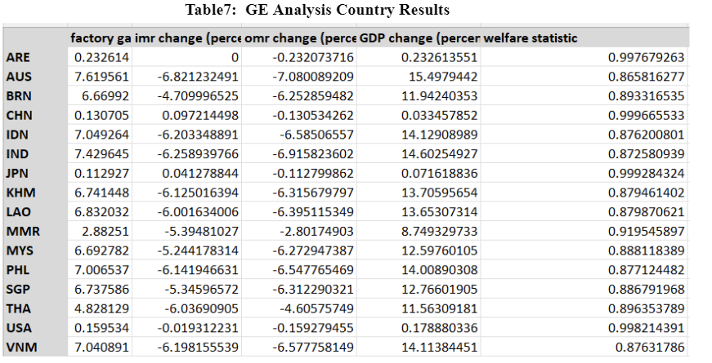
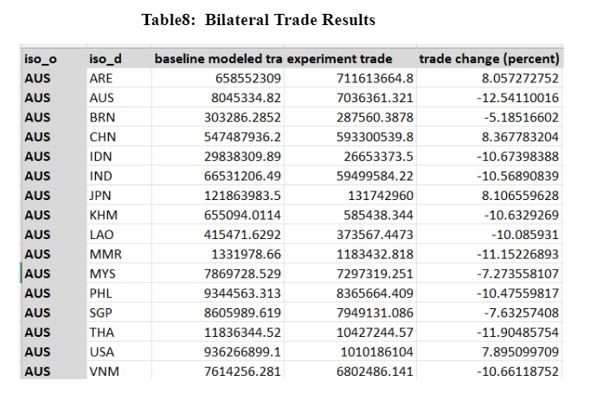
Country and Bilateral Results after Implementation of Counterfactuals
AUSTRALIA

Slide 29
Country Result Interpretation for Australia
The welfare statistic likely measures the economic well-being of each country after Australia joins ASEAN. The marginal positive values in the welfare statistic column could indicate that, according to this model, the countries listed experience a slight increase in economic welfare. This could be due to improved market efficiencies, consumer benefits from increased product variety, and potential gains from trade.
GDP Change- Positive GDP changes for ASEAN member countries could indicate that Australia's entry has potentially led to enhanced economic benefits, such as increased trade flows, investment opportunities, and intensified cooperative economic activities within the bloc. Australia's GDP suggests substantial economic benefits from joining ASEAN, likely due to new market access and integration into ASEAN supply chains.
Factory Price - positive percentages indicate that the factory gate prices in all listed countries increase when Australia joins ASEAN. This could be due to Australia's competitive products entering the market, increased demand for raw materials, or improvements in production efficiency leading to higher-quality goods.
The OMR changes are mostly negative for ASEAN member countries, which suggests that these countries are facing decreased resistance to exporting goods after Australia enters the trade bloc as it will open up new markets for member countries due to lower tariffs within the bloc or harmonized regulations, new technological improvements all these can Australia's entry into ASEAN might open up new markets for member countries due to lower tariffs within the bloc or harmonized regulations, making it easier for them to export.
This negative IMR change for member countries suggests that these countries are facing lesser resistance to importing goods post-Australia joining ASEAN. The reasons for this could include the integration of Australian goods into the ASEAN market These countries are now more open to imports from each other and from Australia, which could lead to greater trade flows and potential economic gains from increased access to goods, technology, and investment.

Slide 30
The baseline modeled trade, which represents the initial trade flows as per the model before any changes, and the experiment trade, which simulates the counterfactual scenario where Australia enters the trade agreement or bloc.
Negative percentage changes in trade flows between Australia and ASEAN member countries suggests a substitution effect which implies that after Australia joins ASEAN, its goods may replace those from other member countries in each respective market due to competitive pricing or quality, leading to a decrease in trade between those ASEAN countries and Australia
Australia's joining ASEAN could lead to a reorientation of supply chains, where Australia becomes a new hub due to its possibly advanced technology and infrastructure, drawing trade away from other ASEAN countries. These changes are for a short period of time due to sudden supply chain change

Slide 31
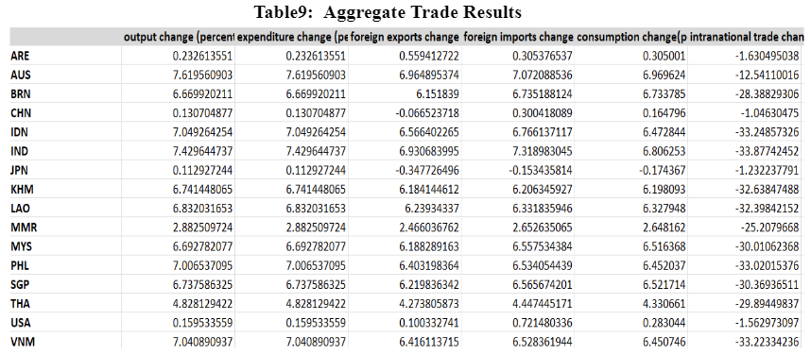
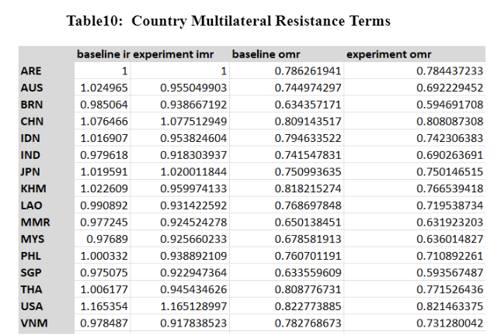
AUSTRALIA

Slide 32
The "consumption change a positive percentage change across all countries, indicating an increase in domestic consumption following Australia's entry into ASEAN. This increase could be due to increased consumer confidence, a more diverse range of products available due to Australia's inclusion, and potentially improved economic conditions within ASEAN countries that boost purchasing power..
The positive changes in "experiment foreign exports" across all listed countries imply that Australia's entry into ASEAN enhances their export opportunities, potentially due to Australia opening its market to ASEAN products or improved trade facilitation within the bloc
The output and expenditure changes are uniformly positive for member countries. This indicates that the benefits derived from economic integration with Australia—such as trade efficiencies, investment, and shared production networks—are substantial. The positive changes for member countries imply that these economies might be experiencing an increase in production capacity and consumer spending, leading to an overall expansion in economic activity.
Experimental IMR is generally less than the baseline, for member countries this suggests that after Australia joins ASEAN, member countries face less resistance to importing goods. This would suggest that joining with Australia makes it easier for these countries to import from the rest of the world, which could be due to Australia's trade networks, technology, and practices enhancing the bloc's import capabilities.
Experiment OMRs have marginally decreased for member countries which show that now after Australia’s entry, ASEAN members are facing slightly less resistance in exporting goods which could be attributed to the integration of Australia's market and the expansion of trade opportunities within ASEAN

Slide 33
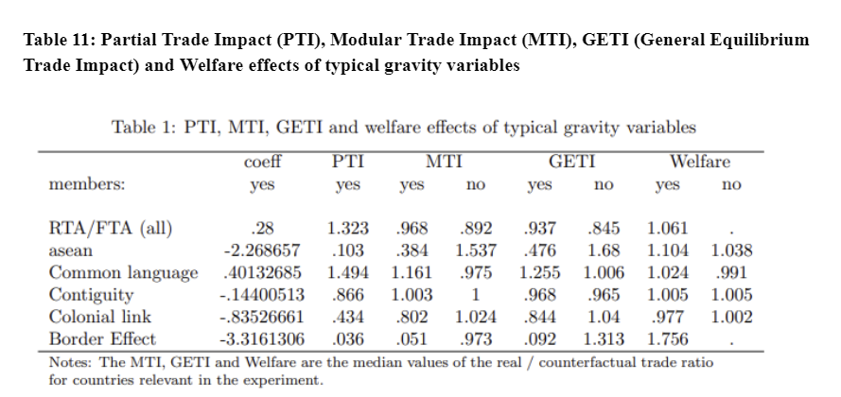
In the table Yes means presence of border and no means border less. The positive coefficient (0.28) for RTA/FTA suggests that, on average, such agreements increase trade flows among member countries and have a positive effect on welfare. With a PTI value above 1 (1.323), it indicates that RTA/FTA increases trade intensity among members more than what is expected without the agreement when other variables are not considered. The GETI for member countries is 0.937 which have RTA and 0.845 for non members which don’t have RTA. Here MTI is smaller than PTI and the difference between MTI and GETI is quite small. ASEAN membership is associated with a significant negative coefficient, suggesting that within the bloc, there might be less trade than expected or that the model may not fully capture ASEAN's trade dynamics.
Welfare effects are positive, indicating that ASEAN membership could be beneficial in broader economic terms, possibly through increased economic integration and stability, despite the reduced trade flows indicated by the negative coefficient. Having a common language generally facilitates trade as the trade effect is more positive for member countries. The border effect has a strong negative coefficient, indicating a significant reduction in trade for countries sharing a border, which may seem counterintuitive since borders typically facilitate trade due to proximity. However, this could also reflect non-tariff barriers or other restrictive policies at borders that are not present in borderless scenarios. Contiguity and colonial link seems to have a negative impact on trade which is counterintuitive and needs more research. Note- Home, asean dummy variable and prevalence score of exporter and importer are found out to estimate the results.

Slide 34
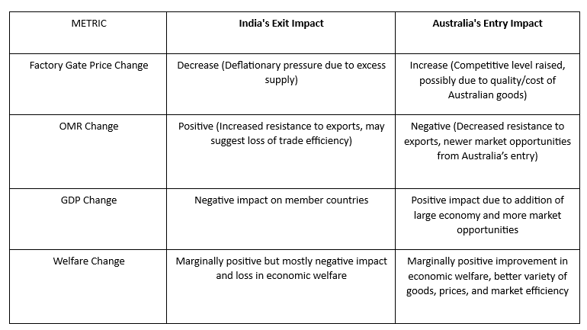
Comaparison

Slide 35
India's trade with the Association of Southeast Asian Nations (ASEAN) has grown significantly in recent years. In 2022, India's trade with ASEAN reached a record high of US$126.3 billion, up from US$96.1 billion in 2021 and ASEAN is now India's third-largest trading partner. , if India leaves Asean it will have a number of negative consequences, it will lose out on the benefits of the ASEAN-India Free Trade Agreement (AIFTA) and would also lose access to the ASEAN market of around 600million people and India's economic growth could be slowed, as ASEAN is a major trading partner of India.
Australia's membership in ASEAN would likely lead to increased trade and investment between Australia and ASEAN countries and can promote regional integration. But some issues are there Australia is a highly developed country, and some analysts have argued that it would be difficult for Australia to find common ground with ASEAN countries on economic issues, they argue that Australia should tie up with more bigger economies like US and UK. So there are diverse political systems and economic development levels impacting Australia’s joining Asean
But from analysis it appears that Australia's entry into ASEAN is the more favorable counterfactual, particularly because it seems to drive economic growth and improve welfare. India's exit, on the other hand, appears to introduce more economic challenges, especially in terms of welfare and trade volume.

Slide 36
Conclusion and Policy implication
Concluding the effects of India leaving ASEAN and Australia joining the bloc would involve significant change in trade dynamics. India’s exit could lead to a decrease in trade diversity for ASEAN, potentially increasing the bloc’s dependence on Australia's economic participation. Conversely, Australia's entry might offer ASEAN access to different markets and sectors where Australia has strong trade ties. ASEAN may need to renegotiate existing trade agreements to account for the changed composition of the bloc. New trade agreements could emphasize leveraging Australia’s economic strengths and relationships. Policy adjustments might be required to integrate Australia’s economy with ASEAN, aligning regulatory standards and practices, and ensuring smooth transitions for supply chains. To counterbalance the loss of India, ASEAN could implement policies to diversify trade and economic ties beyond the bloc, reducing vulnerability to the exit of any single member. Both geopolitical and economic stability are crucial for maintaining investor confidence and trade partnerships. ASEAN might need to engage in diplomatic efforts to maintain regional stability in light of these changes.

Slide 37
Data Sources
The data for gravity modeling has been collected from the Centre for Prospective Studies and International Information (CEPII) database. The export, import and Tariff trade data has been collected from the WITS database for the year 2021. The intra trade data has been collected from Trade Map website.

Slide 38
References
● Gravity with gravitas: A solution to the border puzzle. American economic review, 93(1), 170-192. Anderson, J. E., & Van Wincoop, E. (2003). (Here)
● Head, K., & Mayer, T. (2014). Gravity equations: Workhorse, toolkit, and cookbook. In Handbook of international economics (Vol. 4, pp. 131-195). Elsevier. (Here)
● Herman, P. (2021). Gegravity: General Equilibrium Gravity Modeling in Python. (Here)
● Yotov, Y. V., Piermartini, R., & Larch, M. (2016). An advanced guide to trade policy analysis: The structural gravity model. (Here)

Slide 39
Thank You

